Slide 1

Spring 2022
random variables & their probability distributions
Programming and Data Analysis for Modern Neuroscience
NEU 365P/385L
Marcel Goldschen-ohm
Assistant Professor in the Department of Neuroscience, The University of Texas at Austin

Slide 2
Learning Objectives
You will understand the difference between a probability and a probability density.
You will understand general use cases for Normal, Exponential, Poisson and Binomial distributions.
You will understand the difference between a population distribution and a sampling distribution.
You will appreciate how the Central Limit Theorem explains why Normal-ish distributions are frequently observed in biological measurements.
You will be able to use the SciPy stats module to work with probability distributions.
You will be able to find the value associated with a given percentage of a distribution or vice-versa.
You will be able to plot data distributions as histograms normalized to a probability density.

Slide 3
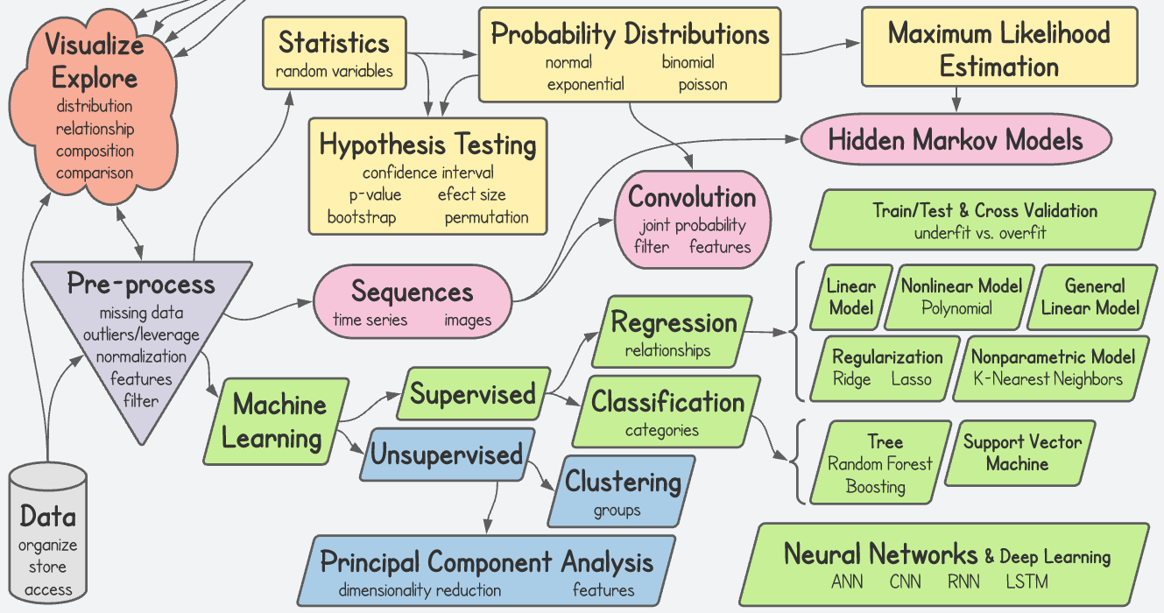
Course Topics Map

Slide 4

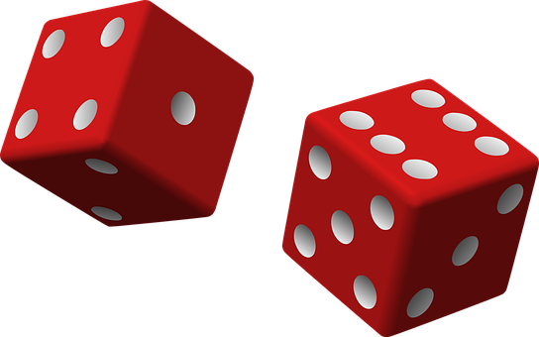
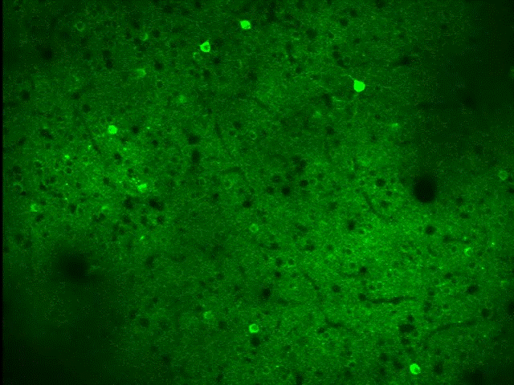
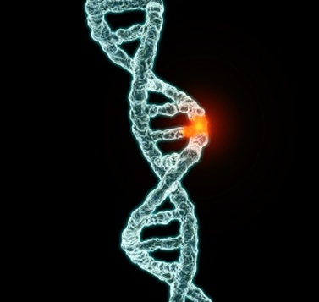

Random Variables

Slide 5
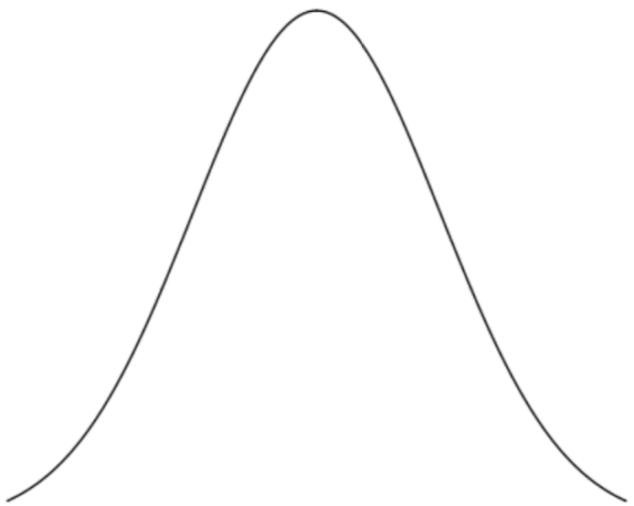
Discrete & Continuous Random Variables
Probability Density
Function (PDF)
Probability
X=A
X=B
X=C
X=D
X
e.g. Tomorrow’s Weather Type
e.g. Tomorrow’s Temperature

Slide 6
Discrete & Continuous Random Variables
Probability Density
Function (PDF)
Probability
X=A
X=B
X=C
X=D
X
e.g. Counting:
How many cells/spikes?
e.g. Classification:
Which cell type?
e.g. Measurement:
Membrane Voltage,
Synapse Volume,
Ca²⁺ Concentration, etc.

Slide 7
Probability Mass = Probability
Probability Mass
Function (PMF)
Probability Density
Function (PDF)
X=A
X=B
X=C
X=D
X
e.g. Counting:
How many cells/spikes?
e.g. Classification:
Which cell type?
e.g. Measurement:
Membrane Voltage,
Synapse Volume,
Ca²⁺ Concentration, etc.

Slide 8
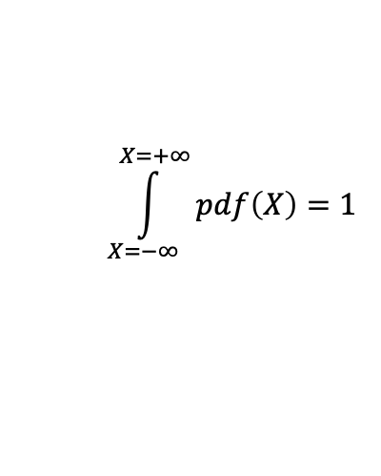
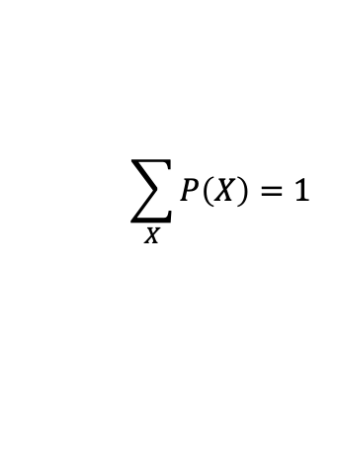
Sum of all possible probabilities = 1
Probability Density
Function (PDF)
Probability
X=A
X=B
X=C
X=D
X
$$\sum_{X}{P\left(X\right)}=1$$
$$\int_{X=−∞}^{X=+∞}{pdf\left(X\right)}=1$$

Slide 9
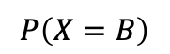
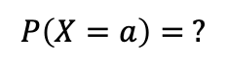
Probability vs. Probability Density
Probability Density
Function (PDF)
Probability
X=A
X=B
X=C
X=D
X=a
$$P\left(X=B\right)$$
$$P\left(X=a\right)= ?$$

Slide 10
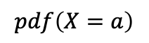
Probability vs. Probability Density
Probability Density
Function (PDF)
Probability
X=A
X=B
X=C
X=D
X=a
Does NOT exist!
$$P\left(X=B\right)$$
$$P\left(X=a\right)= ?$$
$$pdf\left(X=a\right)$$

Slide 11
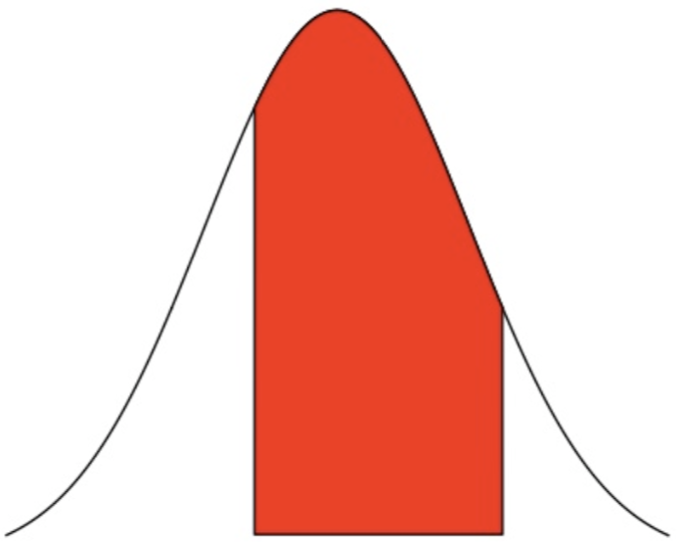
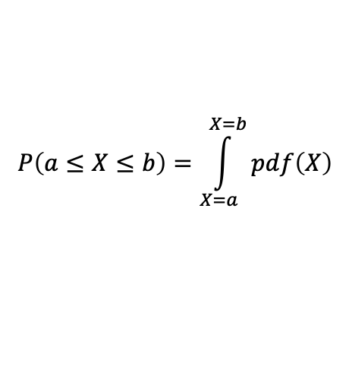
Probability vs. Probability Density
Probability Density
Function (PDF)
Probability
X=A
X=B
X=C
X=D
X=a
X=b
$$P\left(a≤X≤b\right)=\int_{X=a}^{X=b}{pdf\left(X\right)}$$
$$P\left(X=B\right)$$

Slide 12
Cumulative Density Function (CDF)

Slide 13
Survival Function
SF(x=1)
CDF(x=1)

Slide 14
Some common measures of distributions
mean
variance (standard deviation)
median
mode
skewness
kurtosis

Slide 15
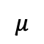
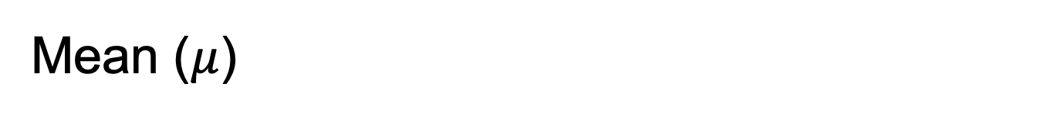
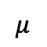
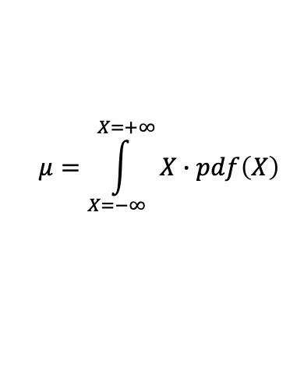
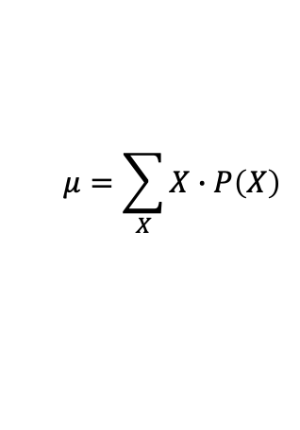
Mean ($μ$)
$$μ$$
$$μ$$
Probability Density
Function (PDF)
Probability
X=A
X=B
X=C
X=D
X
$$μ=\sum_{X}{X∙P\left(X\right)}$$
$$μ=\int_{X=−∞}^{X=+∞}{X∙pdf\left(X\right)}$$

Slide 16
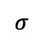
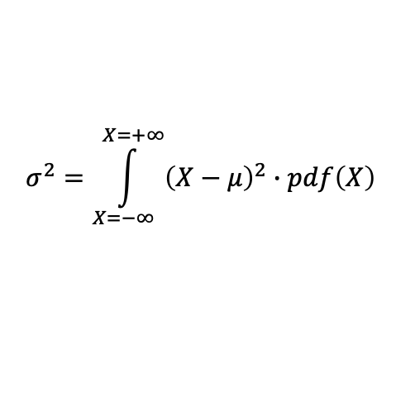
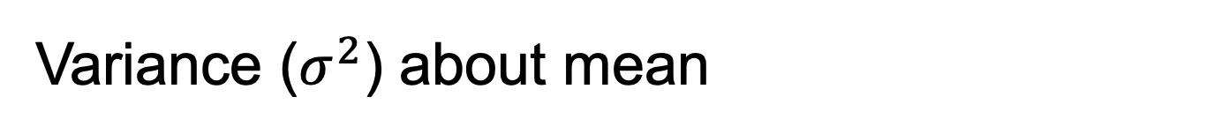
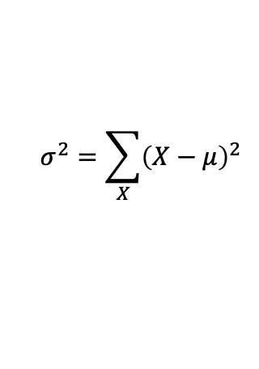
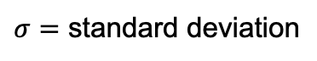
Variance ($σ^{2}$) about mean
$$μ$$
$$μ$$
$$σ$$
Probability Density
Function (PDF)
$σ=$ standard deviation
Probability
X=A
X=B
X=C
X=D
X
$$σ^{2}=\sum_{X}{{\left(X−μ\right)}^{2}}$$
$$σ^{2}=\int_{X=−∞}^{X=+∞}{{\left(X−μ\right)}^{2}∙pdf\left(X\right)}$$

Slide 17
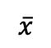
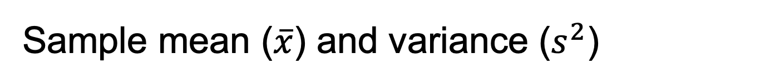
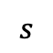
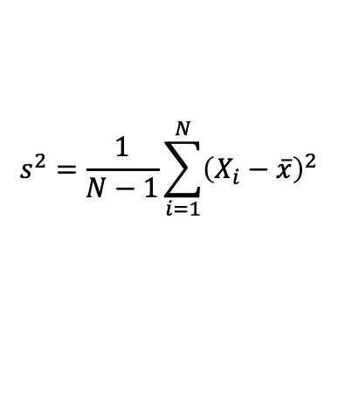
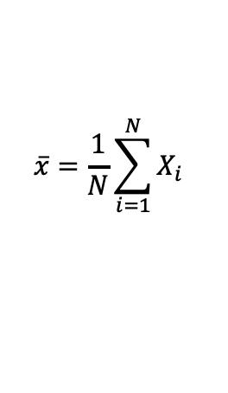
Sample mean ($\overline{x}$) and variance ($s^{2}$)
$$\overline{x}$$
# of Observations
$$s$$
X
$$\overline{x}=\frac{1}{N}\sum_{i=1}^{N}{X_{i}}$$
$$s^{2}=\frac{1}{N−1}\sum_{i=1}^{N}{{\left(X_{i}−\overline{x}\right)}^{2}}$$

Slide 18
Four types of distributions you should know
Normal
Exponential
Poisson
Binomial

Slide 19
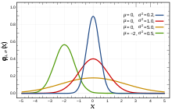
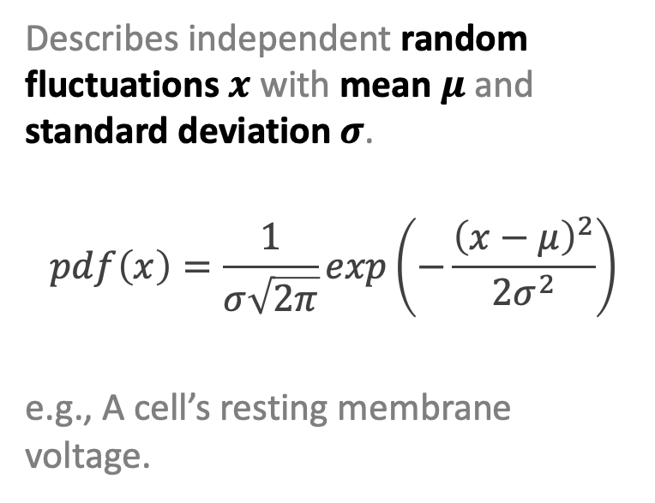
Normal Distribution
Describes independent random fluctuations $x$ with mean $μ$ and standard deviation $σ$.
$$pdf\left(x\right)=\frac{1}{σ\sqrt{2π}}exp\left(−\frac{{\left(x−μ\right)}^{2}}{2σ^{2}}\right)$$
e.g., A cell’s resting membrane voltage.

Slide 20
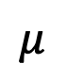
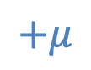
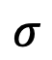
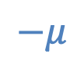
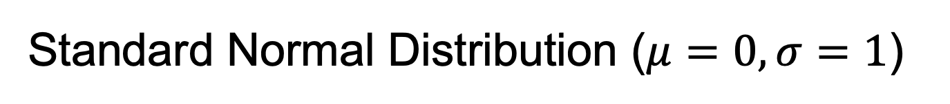
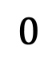
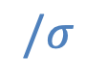
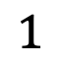
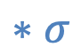
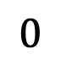
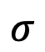
Standard Normal Distribution ($μ=0,σ=1$)
$$∗σ$$
$$+μ$$
$$1$$
$$σ$$
$$σ$$
$$/σ$$
$$−μ$$
$$0$$
$$0$$
$$μ$$

Slide 21
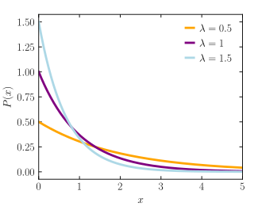
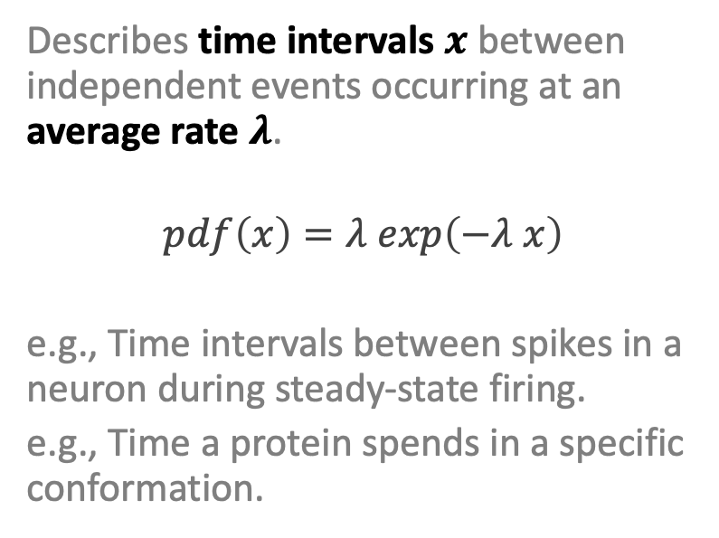
Exponential Distribution
Describes time intervals $x$ between independent events occurring at an average rate $λ$.
$$pdf\left(x\right)=λ exp\left(−λ x\right)$$
e.g., Time intervals between spikes in a neuron during steady-state firing.
e.g., Time a protein spends in a specific conformation.

Slide 22
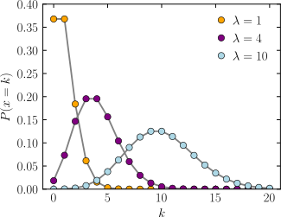
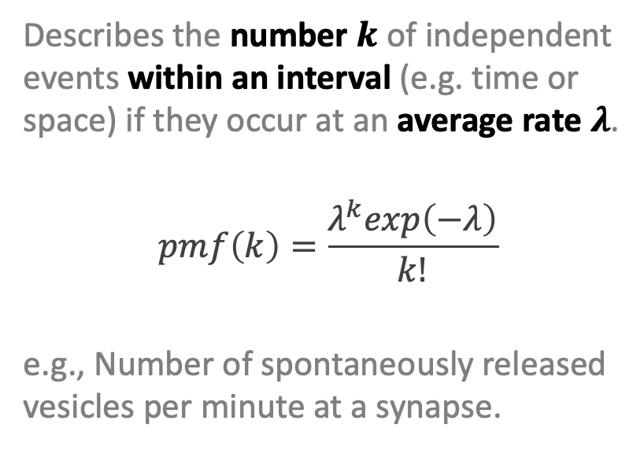
Poisson Distribution
Describes the number $k$ of independent events within an interval (e.g. time or space) if they occur at an average rate $λ$.
$$pmf\left(k\right)=\frac{λ^{k}exp\left(−λ\right)}{k!}$$
e.g., Number of spontaneously released vesicles per minute at a synapse.

Slide 23
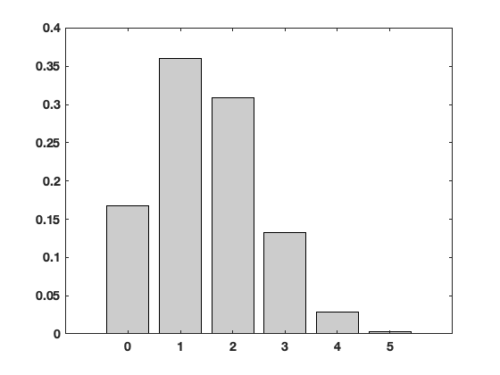
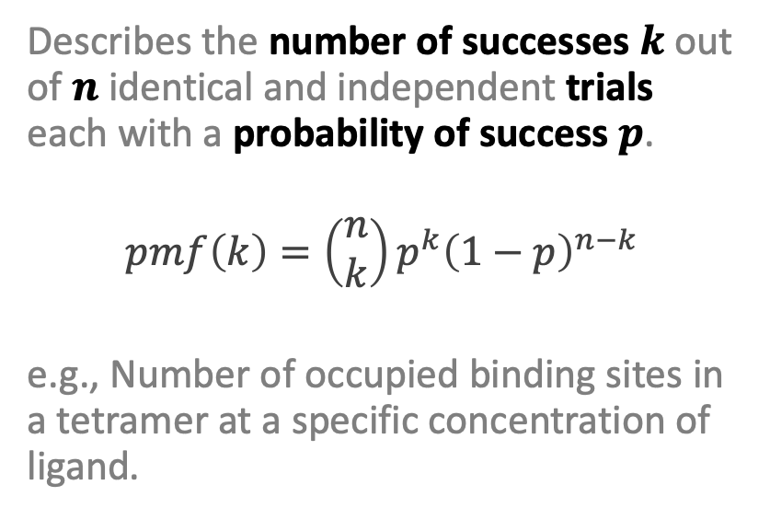
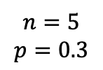
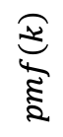
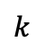
Binomial Distribution
Describes the number of successes $k$ out of $n$ identical and independent trials each with a probability of success $p$.
$$pmf\left(k\right)=\left(\begin{matrix}n \\ k\end{matrix}\right)p^{k}{\left(1−p\right)}^{n−k}$$
e.g., Number of occupied binding sites in a tetramer at a specific concentration of ligand.
$$n=5$$
$$p=0.3$$
$$pmf\left(k\right)$$
$$k$$

Slide 24
What’s so great about using a probability distribution to describe your data?
The entire data distribution is described by a small number of meaningful parameters.
This makes for a very simple data model that is easy to use and easy to interpret.
If your data is well described by a simple probability distribution, then this is most likely what you want to use.

Slide 25
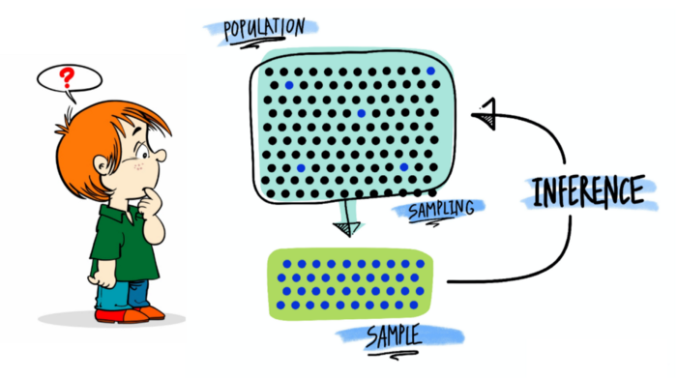
Population vs. Sample

Slide 26





Population vs. Sample
Population
$$μ, σ^{2}$$
$$n$$
$$\overline{x},s^{2}$$
Random Sample of size $n$
$$n$$

Slide 27
















Sampling Distribution
Population
$$μ, σ^{2}$$
$$n$$
$$n$$
$$n$$
$${\overline{x}}_{1},s_{1}^{2}$$
$$n$$
$$n$$
$$n$$
$$n$$
$${\overline{x}}_{2},s_{2}^{2}$$
Distribution of sample means
$$n$$
$$n$$
$$n$$
$${\overline{x}}_{3},s_{3}^{2}$$
$$n$$
…
PDF
$${\overline{x}}_{1}$$
$${\overline{x}}_{2}$$
$${\overline{x}}_{3}$$
$$\overline{x}$$

Slide 28



Central Limit Theorem
For large enough sample size (typically $n≥30$), the distribution of sample means will tend towards a normal distribution about the population mean $μ$ with variance ${σ^{2}}/n$
Population
$$μ, σ^{2}$$
$$n$$
$$n$$
$$n$$
$${\overline{x}}_{1},s_{1}^{2}$$
$$n$$
$$n$$
$$n$$
$$n$$
$${\overline{x}}_{2},s_{2}^{2}$$
$$n$$
$$n$$
$$μ$$
$$n$$
$${\overline{x}}_{3},s_{3}^{2}$$
$$n$$
…
$$\frac{σ}{\sqrt{n}}$$
PDF
$${\overline{x}}_{1}$$
$${\overline{x}}_{2}$$
$${\overline{x}}_{3}$$
$$\overline{x}$$

Slide 29




Central Limit Theorem
For large enough sample size (typically $n≥30$), the distribution of sample means will tend towards a normal distribution about the population mean $μ$ with variance ${σ^{2}}/n$
Population
$$μ, σ^{2}$$
$$n$$
$$n$$
$$n$$
$${\overline{x}}_{1},s_{1}^{2}$$
$$n$$
$$n$$
$$n$$
$$n$$
$${\overline{x}}_{2},s_{2}^{2}$$
$$n$$
$$n$$
$$μ$$
$$n$$
$${\overline{x}}_{3},s_{3}^{2}$$
$$n$$
…
$$\frac{σ}{\sqrt{n}}$$
$$μ$$
PDF
$$σ$$
PDF
The population distribution can be almost anything and this still holds true!
$${\overline{x}}_{1}$$
$${\overline{x}}_{2}$$
$${\overline{x}}_{3}$$
$$\overline{x}$$
Population $x$

Slide 30
Normal-ish distributions are everywhere
Consider a complicated biological processes where the parameter that you measure results from the sum of multiple underlying processes.
By the central limit theorem, we might expect our measurements to have a normal distribution even if the underlying processes do not.

